Slide 1
Chapter 06: Block Cipher Operation
Freshman Seminar
2022.01.14
Sumin Sohn

Slide 2
Contents
6.2 Electronic Code Book
6.3 Cipher Block Chaining Mode
6.4 Cipher Feedback Mode
6.5 Output Feedback Mode
6.6 Counter Mode

Slide 3
6.2 Electronic Code Book(ECB)

Slide 4
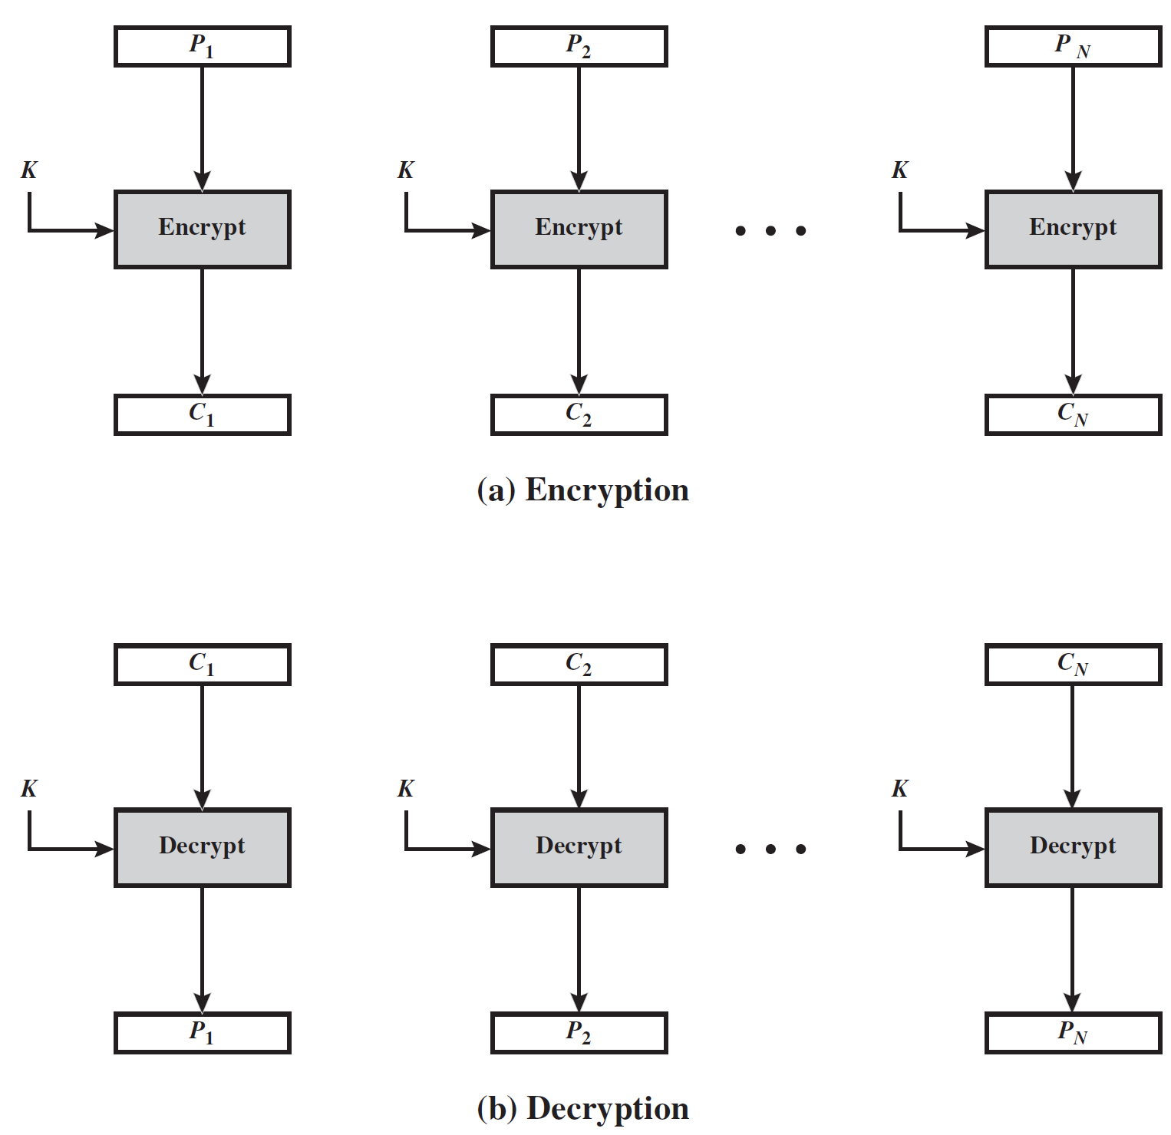
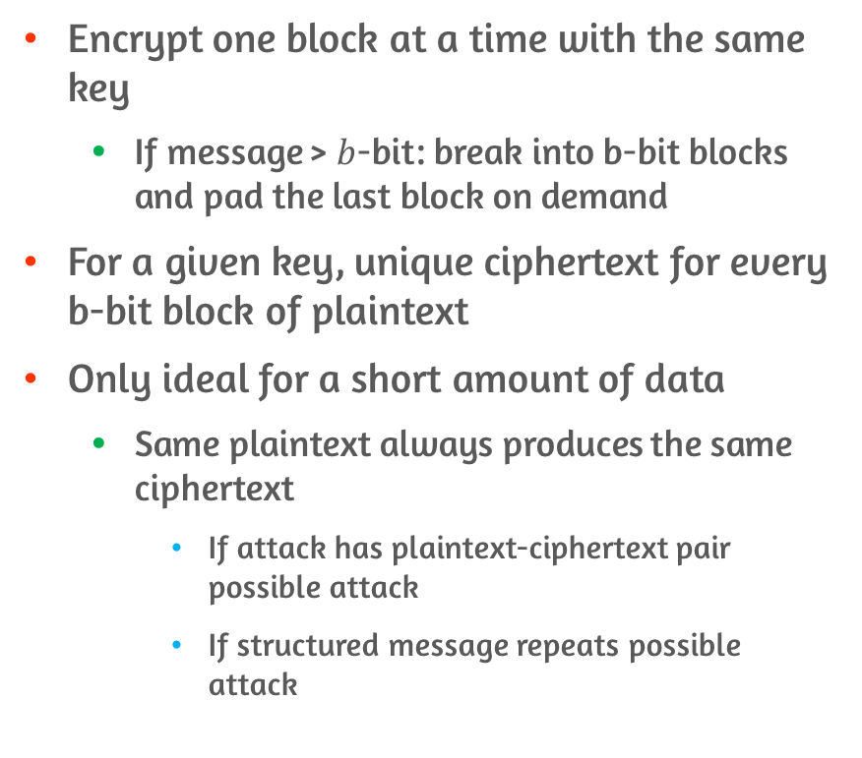
Features of ECB
Encrypt one block at a time with the same key
If message > $b$-bit: break into b-bit blocks and pad the last block on demand
For a given key, unique ciphertext for every b-bit block of plaintext
Only ideal for a short amount of data
Same plaintext always produces the same ciphertext
If attack has plaintext-ciphertext pair possible attack
If structured message repeats possible attack

Slide 5
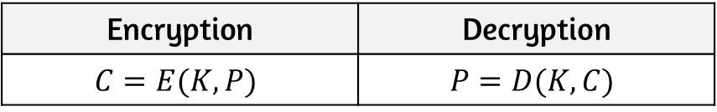
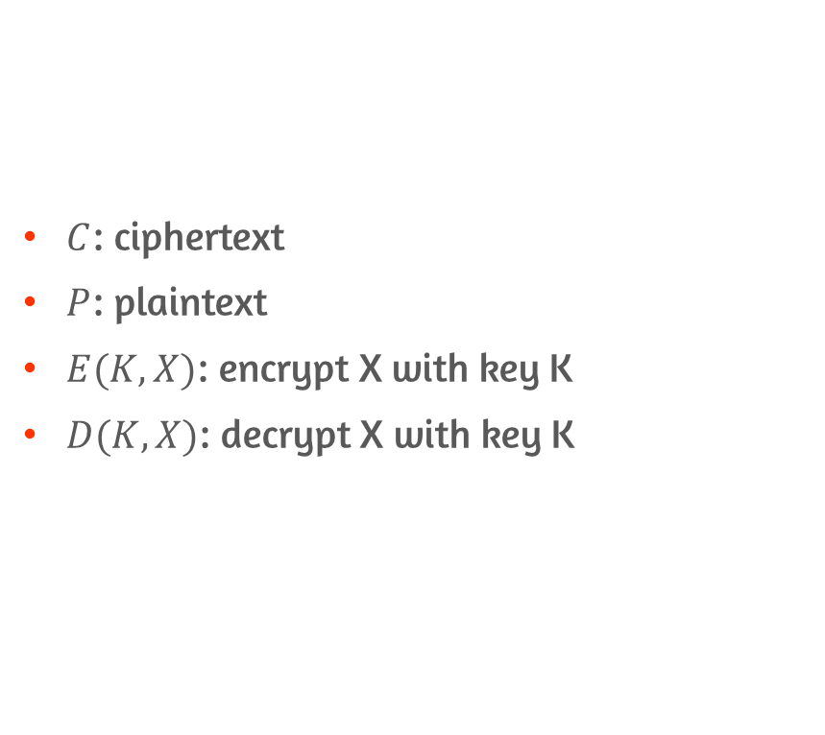
Encryption and Decryption of ECB
$C$: ciphertext
$P$: plaintext
$E(K, X)$: encrypt X with key K
$D(K, X)$: decrypt X with key K
Encryption | Decryption
$$C=E(K,P)$$ | $$P=D(K,C)$$

Slide 6
6.3 Cipher Block Chaining(CBC) Mode

Slide 7
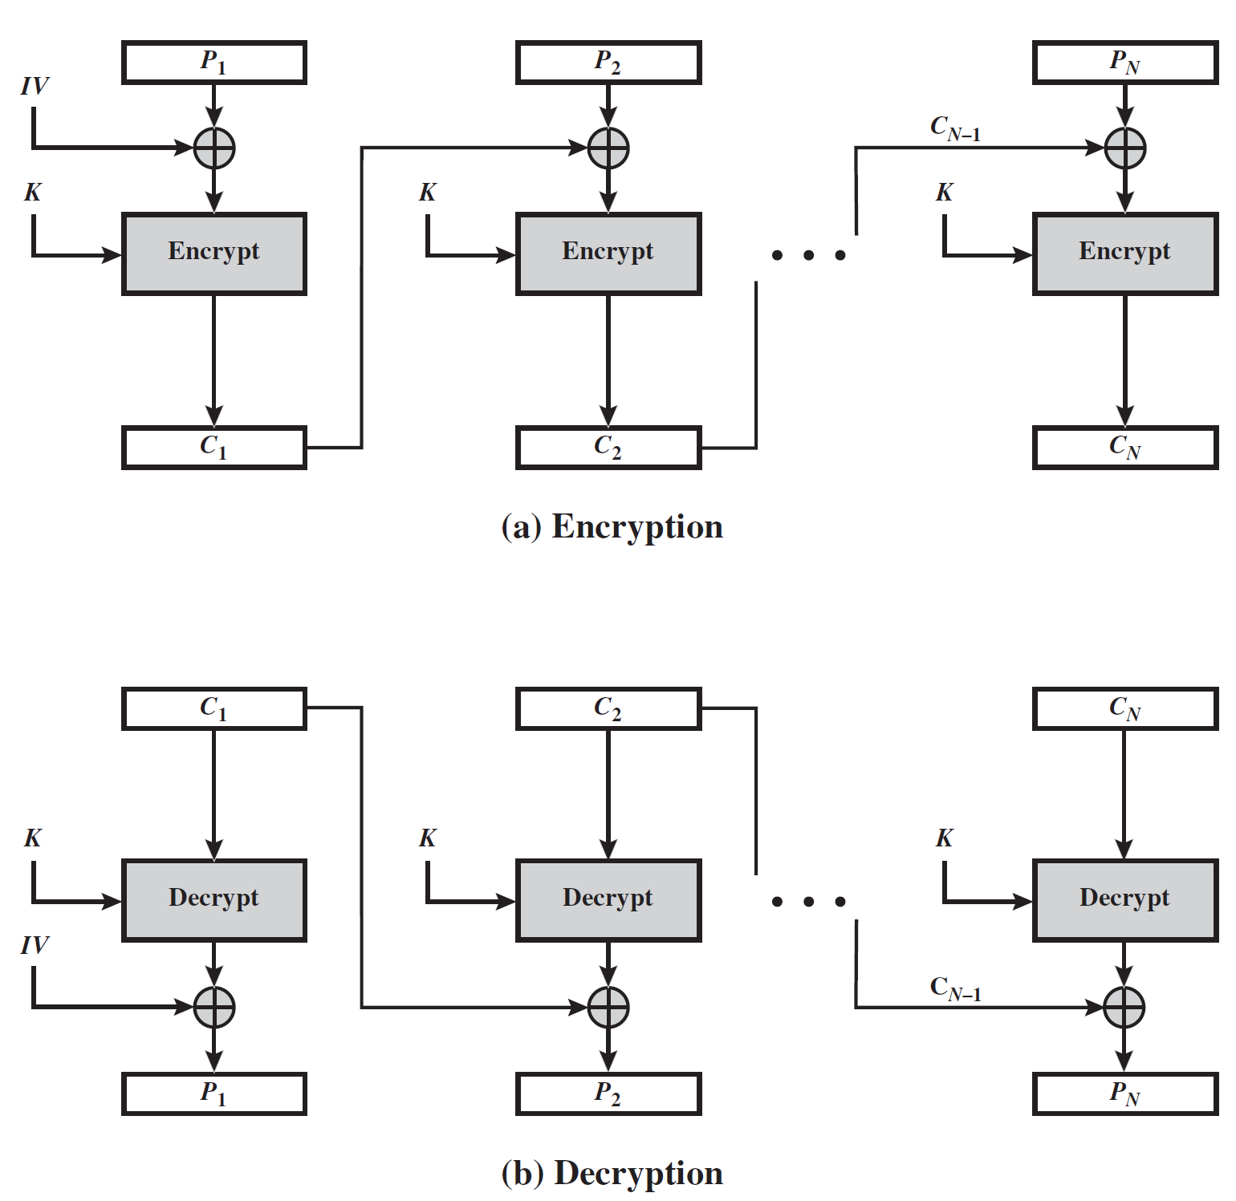
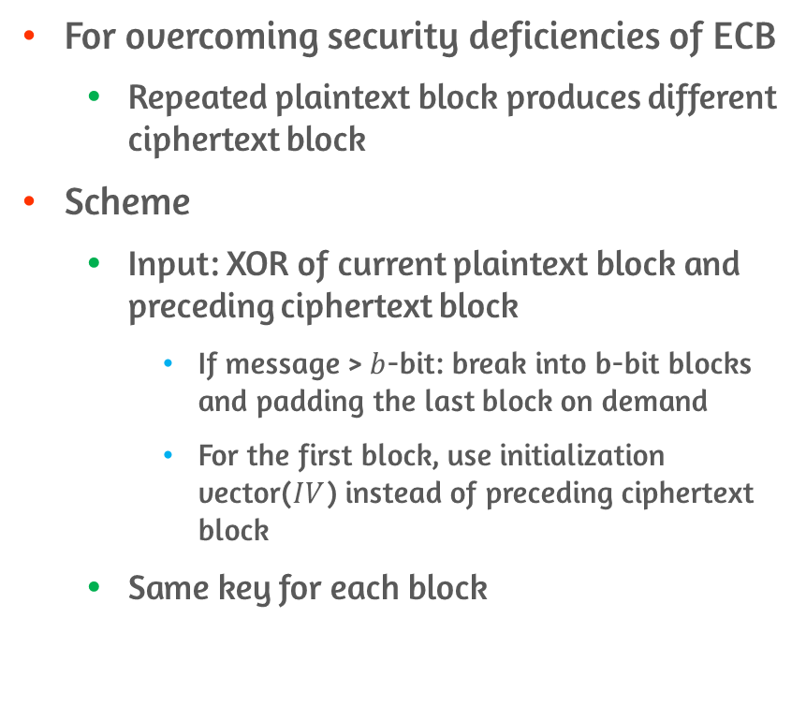
Features of CBC
For overcoming security deficiencies of ECB
Repeated plaintext block produces different ciphertext block
Scheme
Input: XOR of current plaintext block and preceding ciphertext block
If message > $b$-bit: break into b-bit blocks and padding the last block on demand
For the first block, use initialization vector($IV$) instead of preceding ciphertext block
Same key for each block

Slide 8
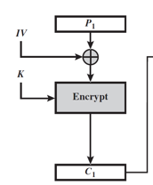
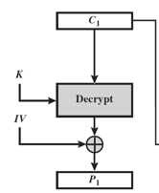
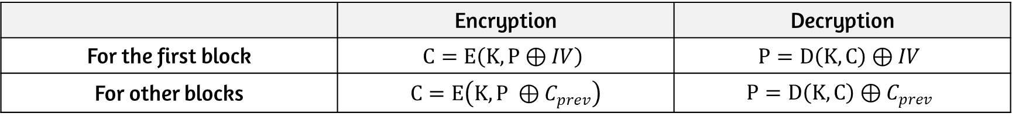
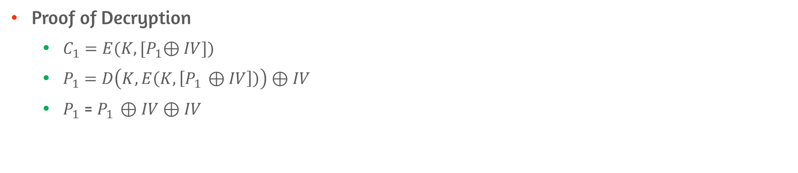
Encryption and Decryption of CBC
 | Encryption | Decryption
For the first block | $$C=E\left(K, P⊕IV\right)$$ | $$P=D\left(K, C\right)⊕IV$$
For other blocks | $$C=E\left(K, P ⊕C_{prev}\right)$$ | $$P=D\left(K, C\right)⊕C_{prev}$$
Proof of Decryption
$C_{1}=E(K, {[P}_{1}⊕IV])$
$P_{1}=D\left(K,E\left(K,\left[P_{1 }⊕IV\right]\right)\right)⊕IV$
$P_{1}$ = $P_{1 }⊕IV⊕IV$

Slide 9
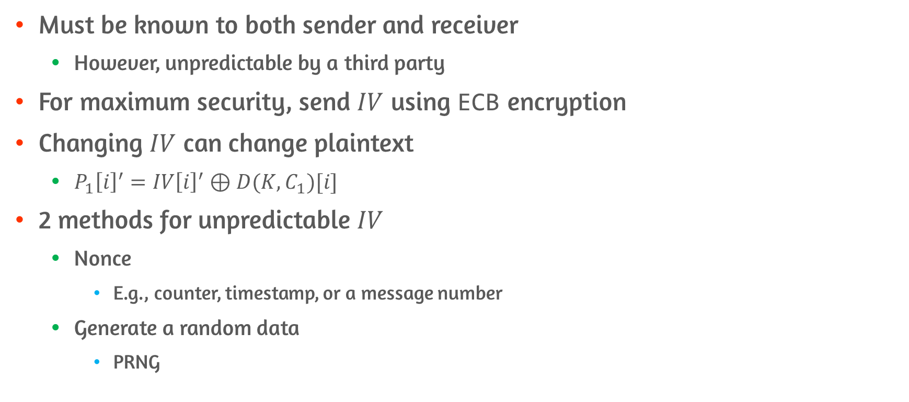

Initialization Vector($IV$)
Must be known to both sender and receiver
However, unpredictable by a third party
For maximum security, send $IV$ using ECB encryption
Changing $IV$ can change plaintext
$P_{1}{\left[i\right]}^{′}=IV{\left[i\right]}^{′}⊕D(K,C_{1})[i]$
2 methods for unpredictable $IV$
Nonce
E.g., counter, timestamp, or a message number
Generate a random data
PRNG

Slide 10
6.4 Cipher Feedback(CFB) Mode

Slide 11
Using Block Cipher like Stream Cipher
Stream cipher eliminates the need to pad a message
Can operate on real time
Encrypt and transmit immediately using a character-oriented stream cipher
Example
Cipher Feedback(CFB)
Output Feedback(OFB)
Counter(CTR)

Slide 12
Features of CFB
Ciphertext is Same length as the plaintext
Unit of transmission is s-bit
Commonly, s = 8
Plaintext is divided into segments of s bits
Only Encryption function is used

Slide 13
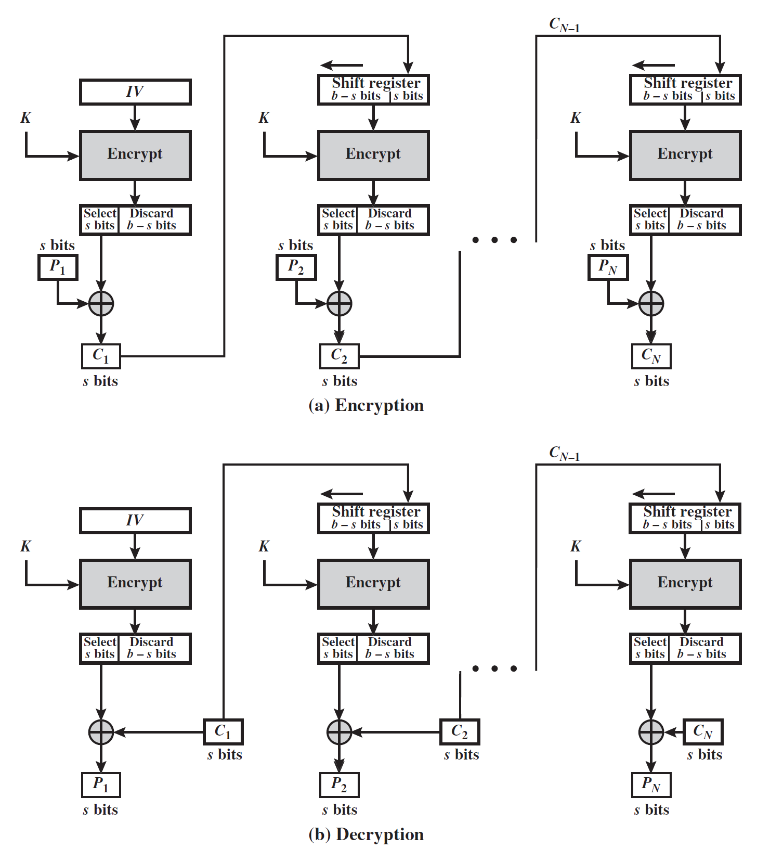
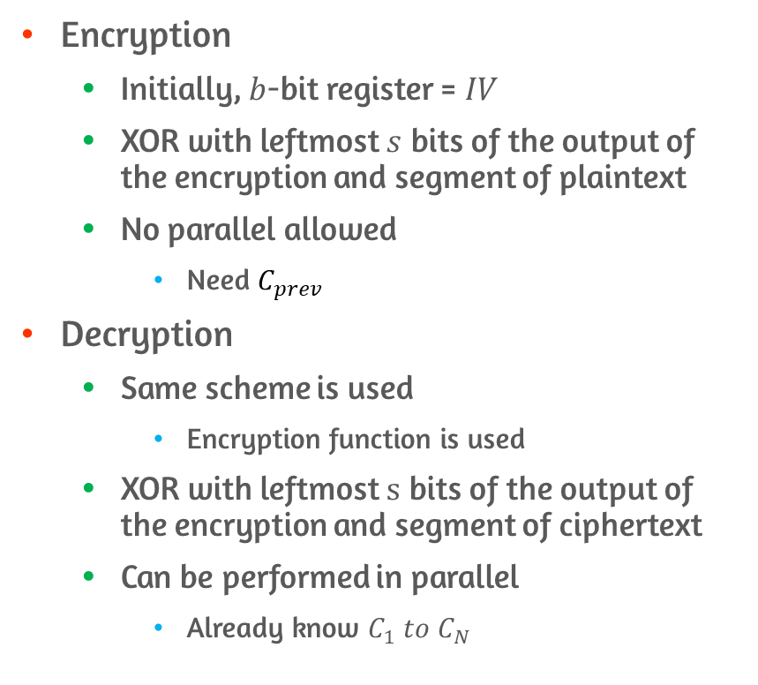
Encryption and Decryption of CFB
Encryption
Initially, $b$-bit register = $IV$
XOR with leftmost $s$ bits of the output of the encryption and segment of plaintext
No parallel allowed
Need $C_{prev}$
Decryption
Same scheme is used
Encryption function is used
XOR with leftmost $s$ bits of the output of the encryption and segment of ciphertext
Can be performed in parallel
Already know $C_{1} to C_{N}$

Slide 14
6.5 Output Feedback(OFB) Mode

Slide 15
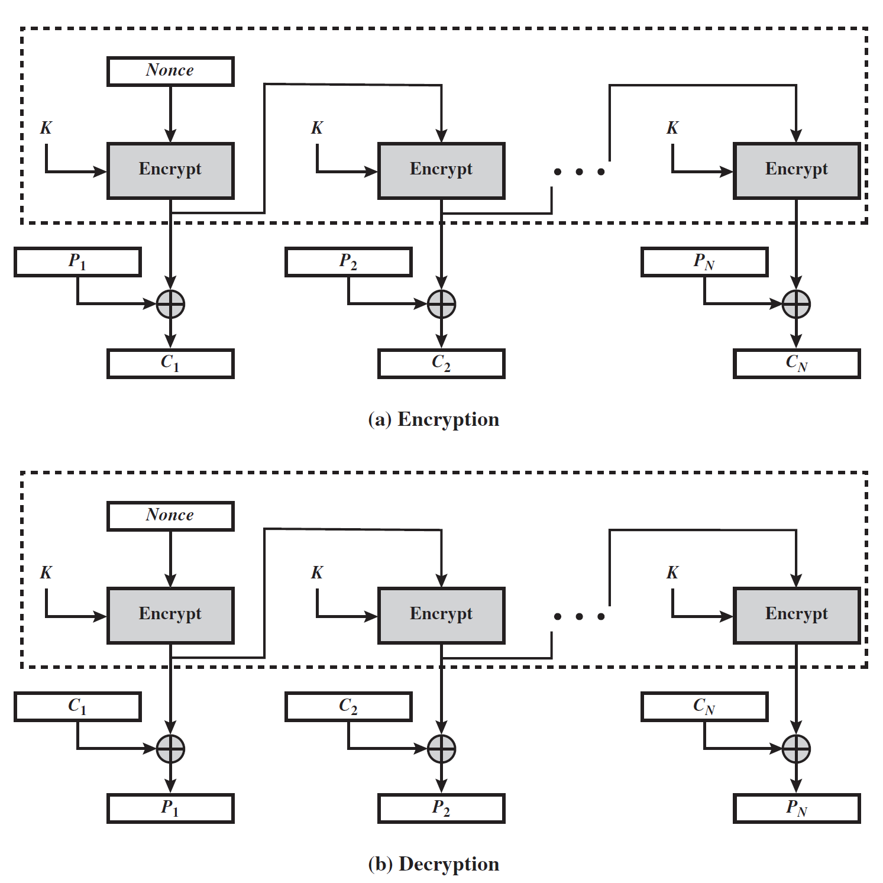
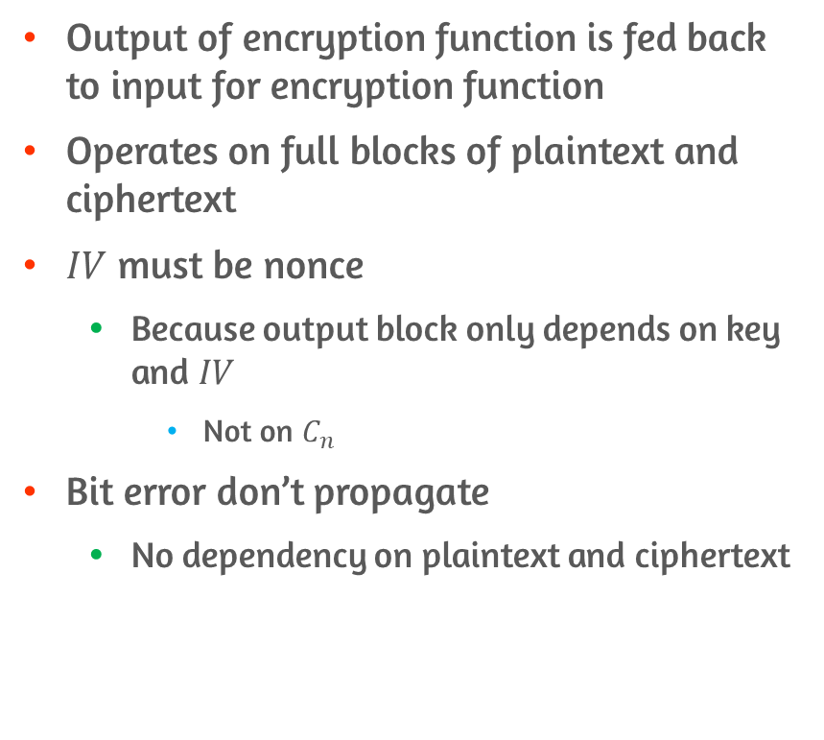
Features of OFB
Output of encryption function is fed back to input for encryption function
Operates on full blocks of plaintext and ciphertext
$IV$ must be nonce
Because output block only depends on key and $IV$
Not on $C_{n}$
Bit error don’t propagate
No dependency on plaintext and ciphertext

Slide 16
6.6 Counter(CTR) Mode

Slide 17
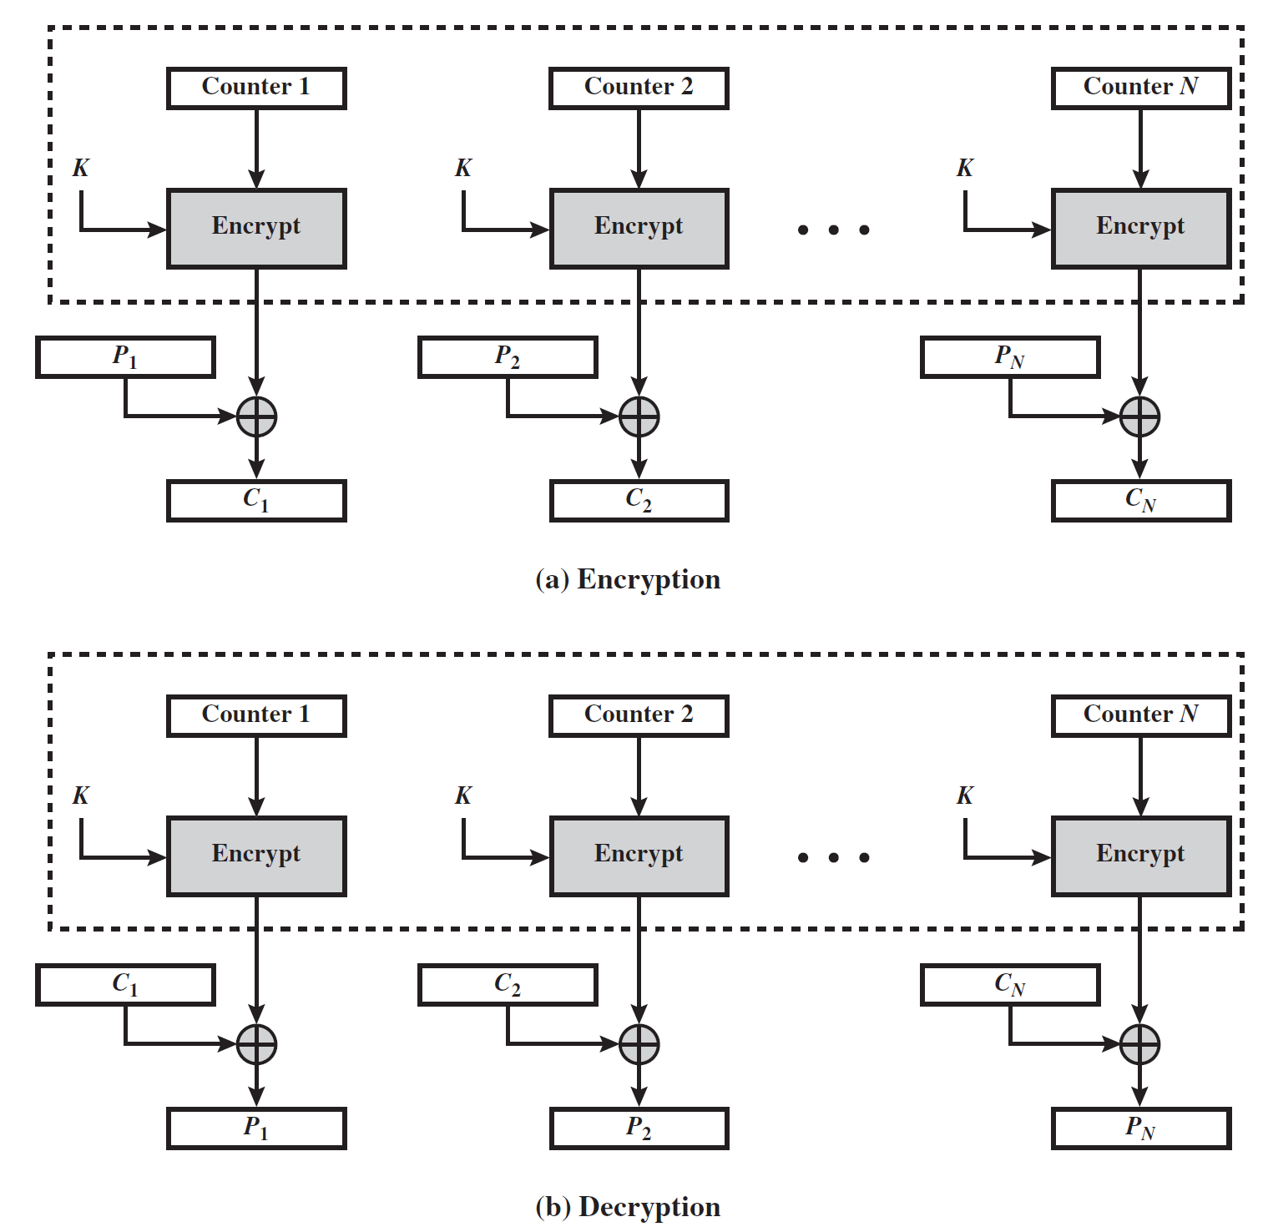
Encryption and Decryption of CTR
Encryption
XOR with encrypted counter and plaintext block
No chaining
Decryption
XOR with encrypted counter and ciphertext block
Initial counter value must be available

Slide 18
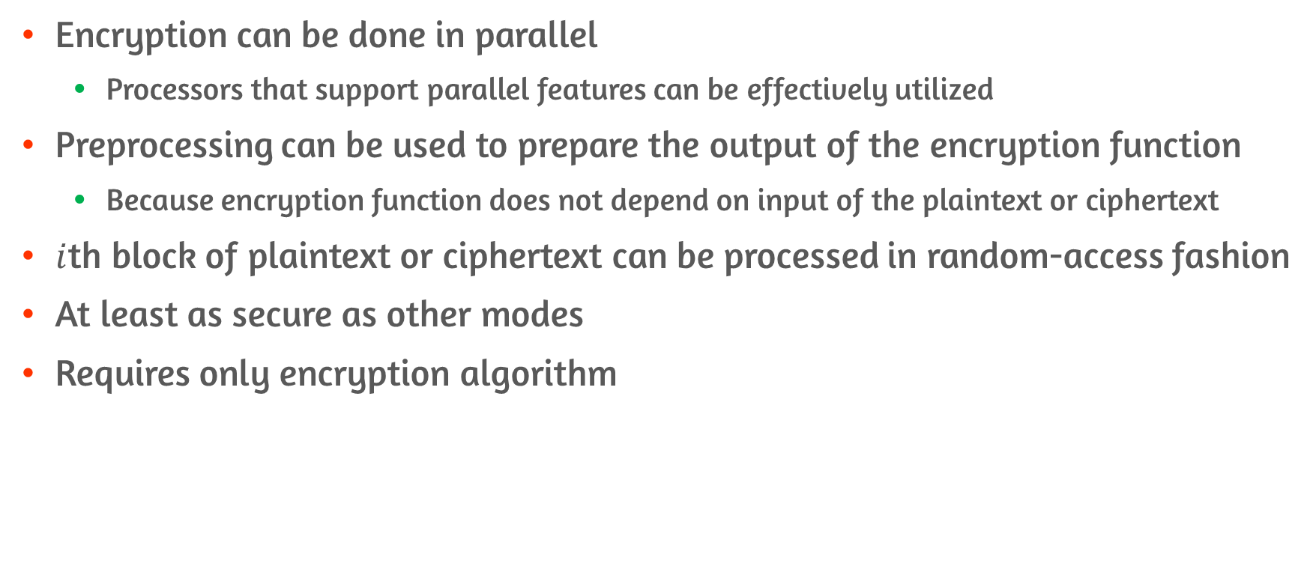
Advantages of CTR mode
Encryption can be done in parallel
Processors that support parallel features can be effectively utilized
Preprocessing can be used to prepare the output of the encryption function
Because encryption function does not depend on input of the plaintext or ciphertext
$i$th block of plaintext or ciphertext can be processed in random-access fashion
At least as secure as other modes
Requires only encryption algorithm

Slide 19
Conclusion
ECB
CBC
CFB
OFB
CTR

